Slide 1
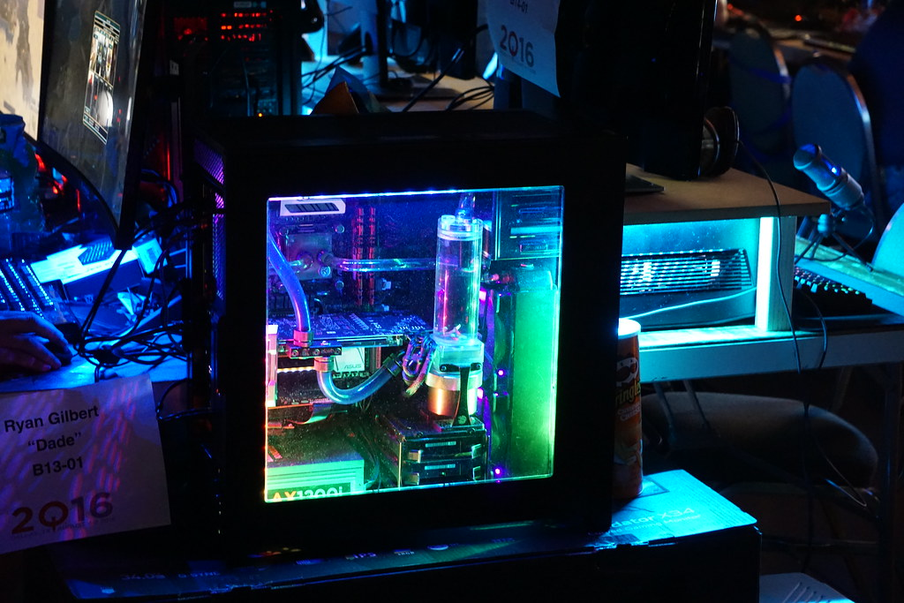
GOOLINE
Ahmed Kasteer 20F-0336
Ahmed Bilal 20F-1026
Shamikh Sameer 20F-1056​
This Photo by Unknown Author is licensed under CC BY

Slide 2

About us
At Gooline, we empower our platform to foster collaborative thinking to further drive workplace innovation. By closing the loop on video games as well as Software using the latest technology, we help both, gamers as well as users grow and nurture a consumer-first mindset.

Slide 3

Problem Statement
Market gap
Customers
Usability
Many customers need access to both games and software together but are using old or outdated platforms and keep revisiting different sites to download them.
10% increase of Discount and 20% of increase in software availability proves that there's consumer interest for more simple management of wanting games and software available on a single platform
Customers want something that’s easy to adopt, is available on multiple platforms and simple to use.
Costs
Loss of sales by not offering easier access to the availability of software and games that push consumers to their satisfaction.

Slide 4
Solution
Close the gap
Target audience
Our product makes downloading both games and software easier, and no other product on the market offers the same benefits
Gen Z (18-25 years old) along with Working Adults (25 and onwards..)
Cost savings
Easy to use
Reduce costs for client by leasing both software and games so that revenue stays on target within deadlines
A simple platform that provides users the games or software they need in order to compete in games as well as work on given deadlines at the office.

Slide 5




Product Overview
Unique
First to market
Tested
Authentic
Only platform specifically dedicated to combined availability of games and software together.
First beautifully designed product that's both stylish and functional
Conducted testing with start ups in the area
Designed with the help and input of software experts

Slide 6

GOOLINE benefits
Simple and efficient to use.
Quick customer service assistance.​
Free 90-day trial for new customers.​​

Slide 7

Company overview

Slide 8

Our competition
STEAM​
ORIGIN EPIC GOOLINE
Video games available but with a hefty price tag. Discounts are seasonal.
Game streaming services with digital rights management.
Available on Windows and MAC OS.
AAA Titled EA exclusive games available with a hefty price tag.
Good customer service with digital rights management and a pro membership plan for exclusive content.
Available on Windows and MAC OS.
Provides free MODS to the existing variety of games. Hub of the most played games.
Discounts for award wining games through out the year.
Available on Windows.
Variety of games to choose from purchased on lease for people who can not afford.
Not only games but software are available for download as well including Video editing software, office software and many more.
Multi-platform availability for Windows, MAC OS, PlayStation and Xbox.

Slide 9
competition
Convenient
GOOLINE
STEAM
Expensive​
Affordable
EPIC
ORIGIN
Inconvenient​

Slide 10
Growth strategy
How we’ll scale in the future​
Feb 2023
May 2023
Oct 2023
Distribute the platform to local start ups to help establish the product
Release the platform to the general public and monitor press and regional market trends
Gather feedback from the start up community to expand availability of the platform

Slide 11

Thank you

